Slide 1



2nd AICTE-ECI-ISTE Chhatra Vishwakarma Awards
“Improving the Rural School Environment”
Team Name: Edu-Bridge
APPLICATION ID: VIS0908134528
Ch.Haarika(TL)
Mrs. R.Sailaja
Ashish Kumar
P.Rachana
K.Swarnamika

Slide 2
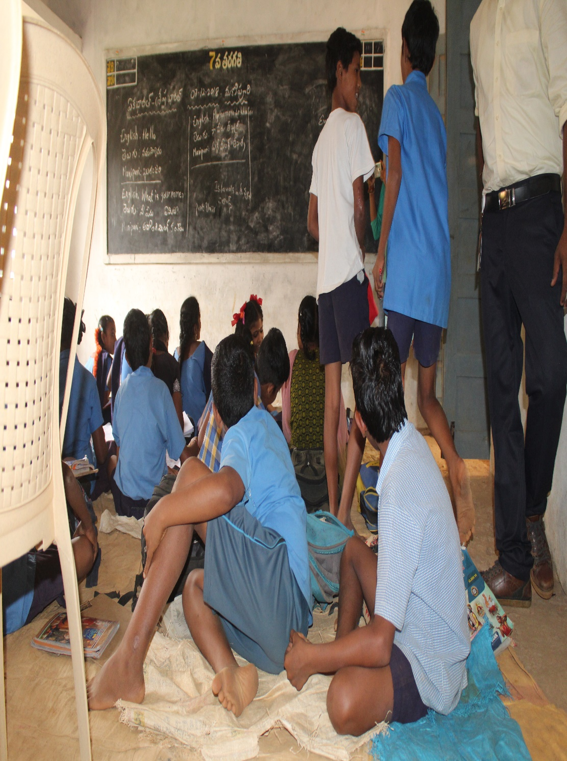
Problem Statement
During the year 2015-2016 student’s enrolment in to government schools across 20 Indian states had fell by 13 million , while private schools acquired 17.5 million new students. The main reason for this down fall is lack of good infrastructure, teachers, facilities and delay in government response. To resolve this problem, the government is taking some steps and instructing the MEO’s and DEO’s regularly in this regard. But this communication is going through letters which consumes much time in implementation and also increases paper work.

Slide 3
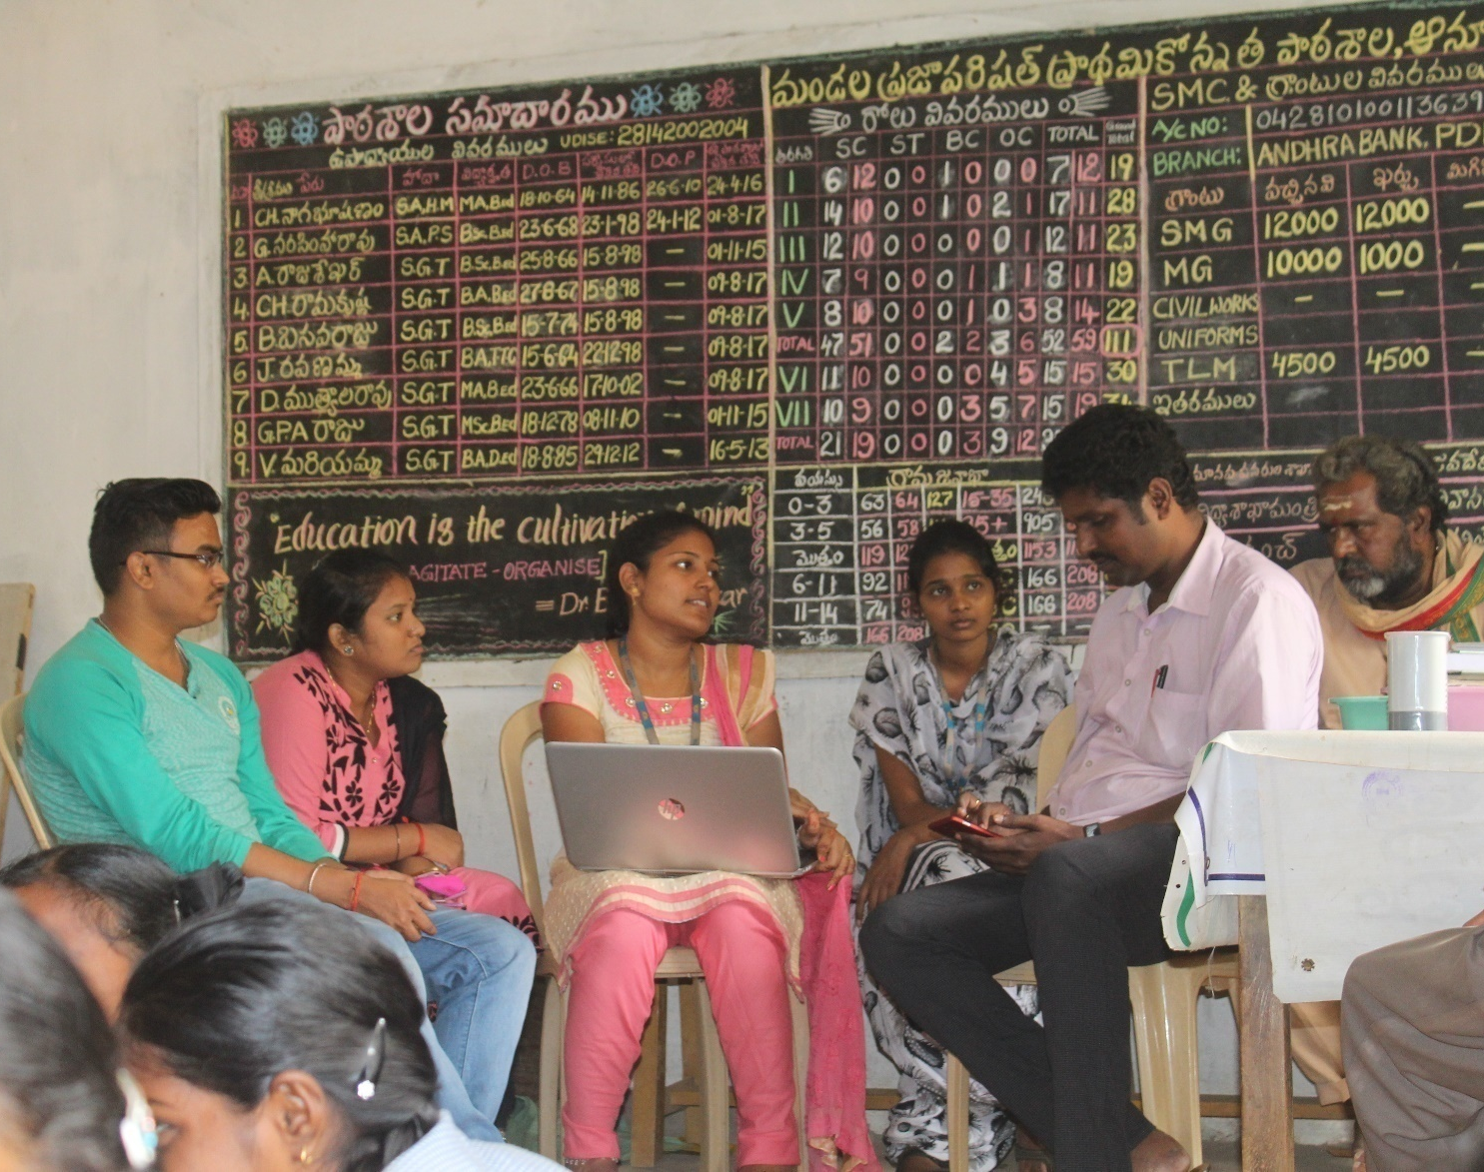
Scenario Description
During the year 2015-2016 student’s enrolment in to government schools across 20 Indian states had fell by 13 million , while private schools acquired 17.5 million new students. The main reason for this down fall is lack of good infrastructure, teachers, facilities and delay in government response.

Slide 4
Solution
The solution for this problem is to use media which consumes less time to send the information.
For that, we are planning to develop a website which takes the requirements regarding infrastructure of Primary, Upper Primary & High School from staff(Head Master, Incharge HeadMaster, Faculty, S.M.C(School Management Committee)) and send it to the Mandal Educational officer (MEO) and District Educational officer (DEO).
As a result, the information can be reached in accurate time and the government can get the information when ever required and respond according to it.

Slide 5
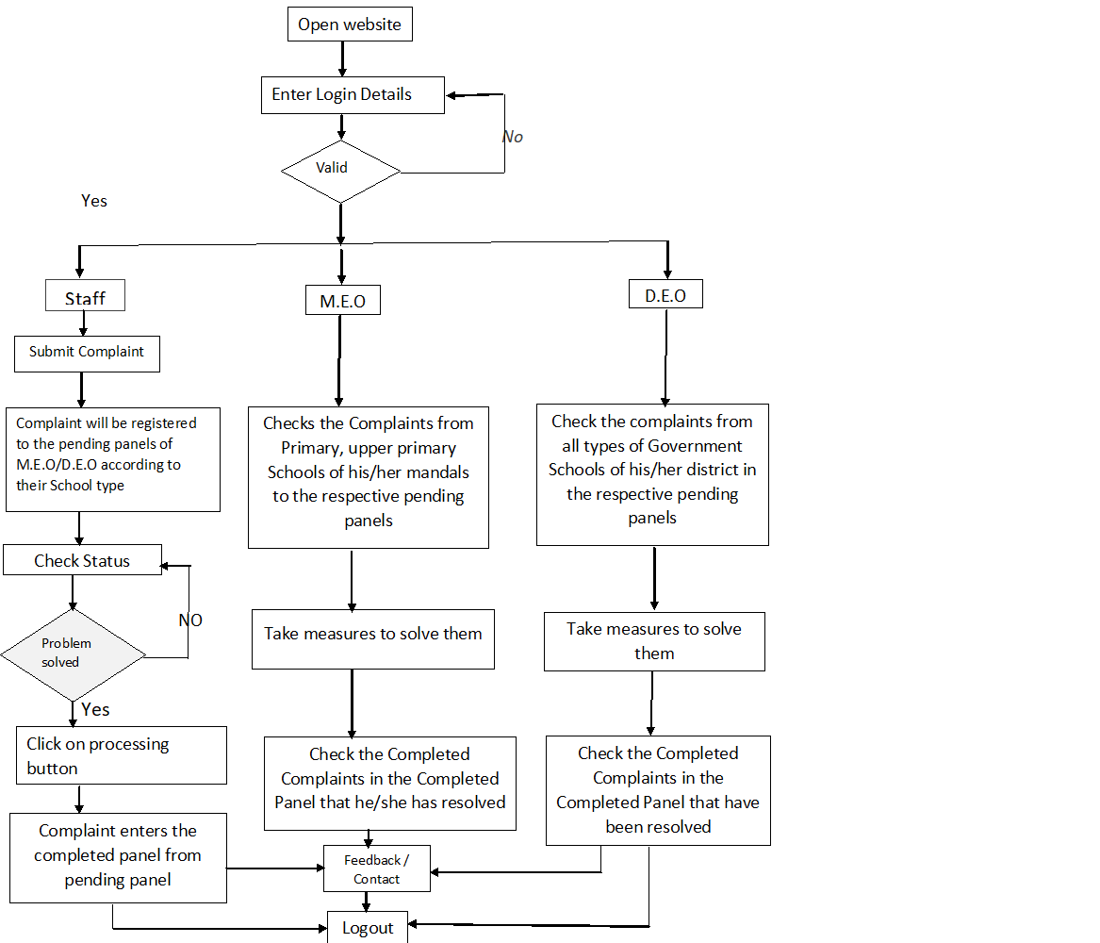
Flow Diagram

Slide 6
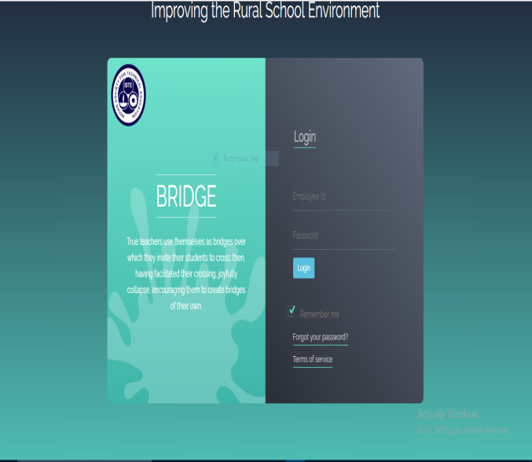
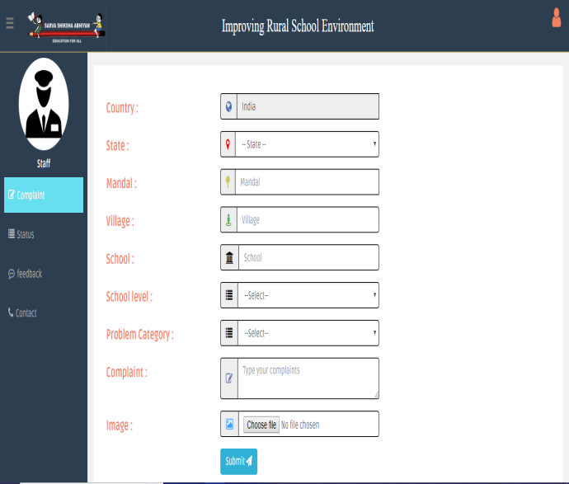
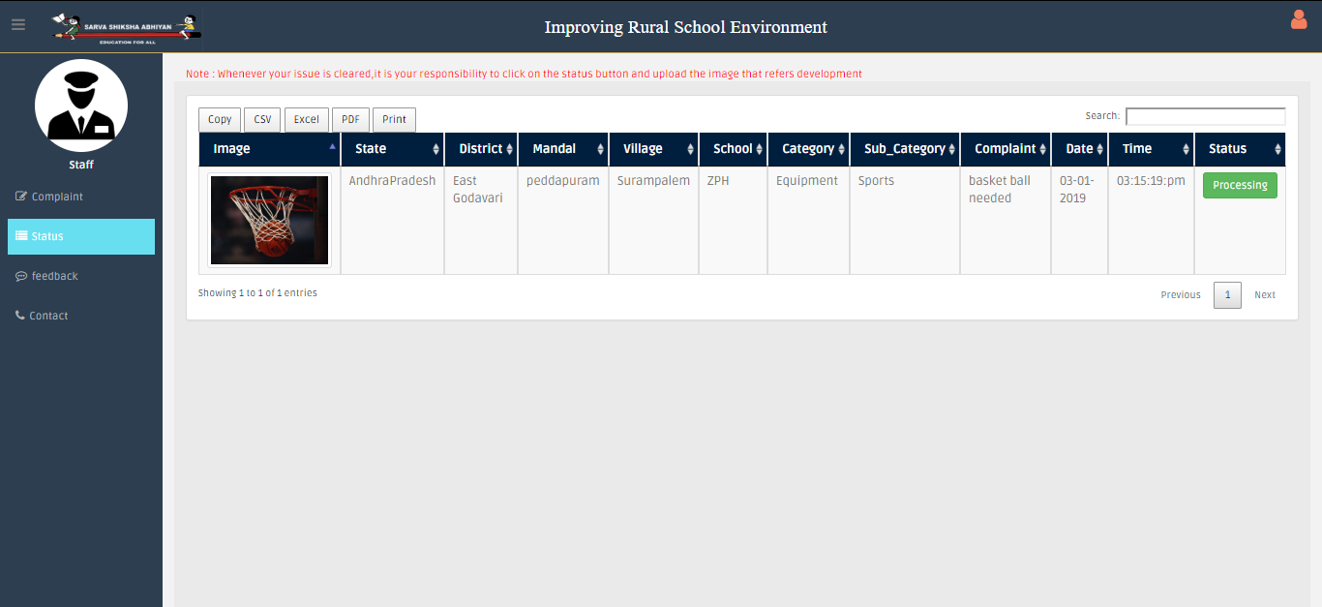
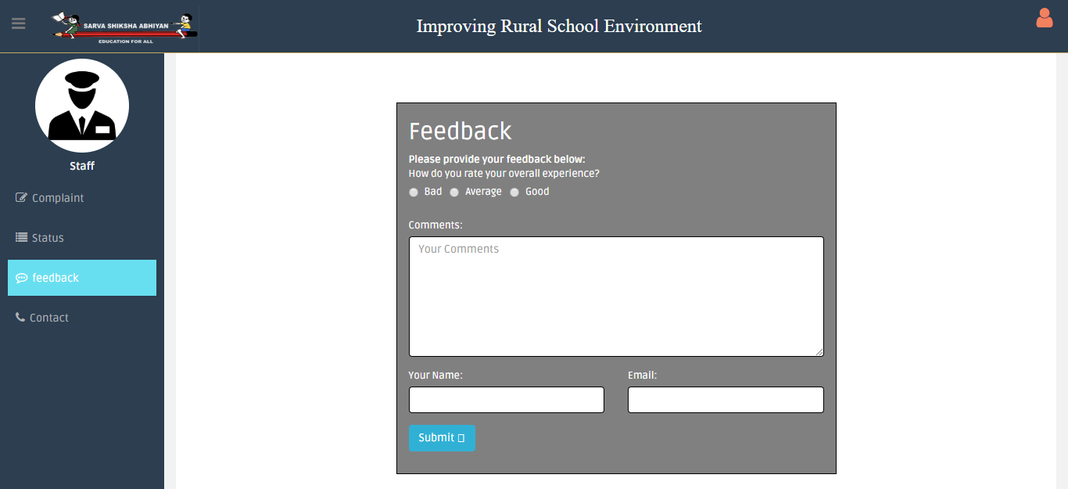
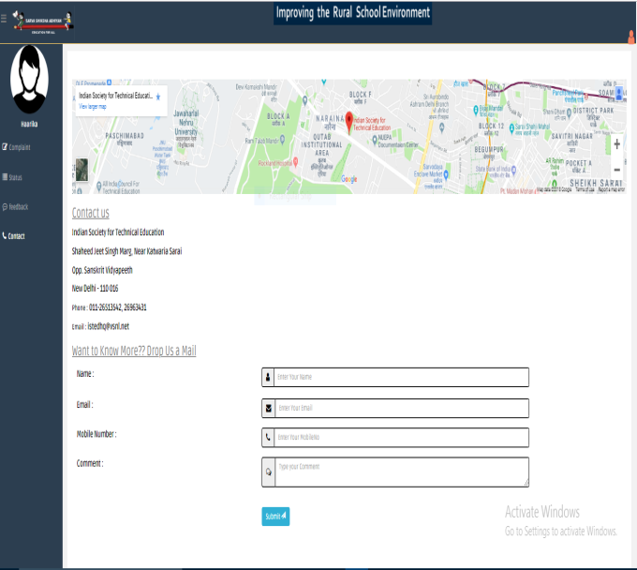
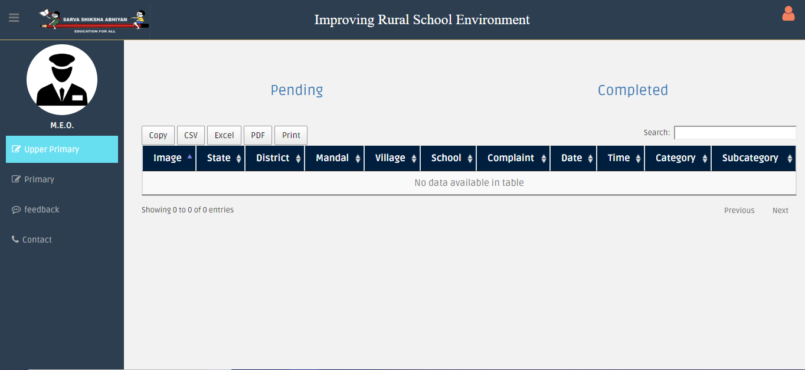
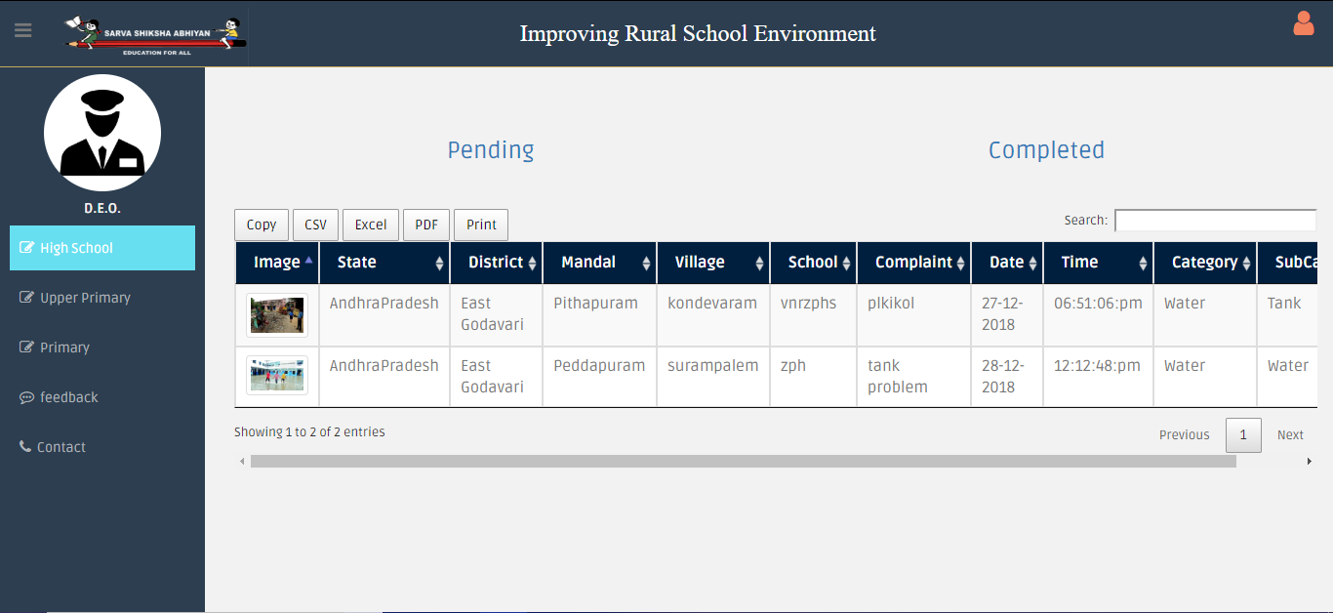
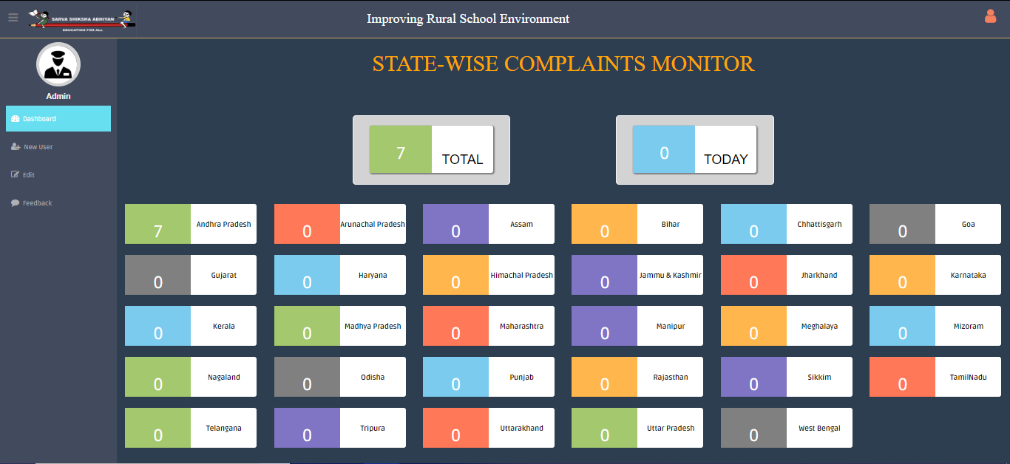
Pictures

Slide 7
Prospective Impact
Improving the infrastructure of govt. schools will improve education environment.
People will also show interest towards govt. schools & hence enhancing the govt. schools strength.
Increasing in govt. school admissions will leads to quality education with low price.
Children’s education standard will enhance resulting in enhancing the society development.

Slide 8
Novelty
It will provide a platform for the govt. faculties to interact with higher authorities.
It’s cost effective; around Rs.1000 per annum.
As per our knowledge, it is completely a new solution which is not available in the market.

Slide 9
Roadmap to Market
Delivering the product in software model like website.
Our target beneficiary is to use the website in every government school and to improve Rural School Environment.
Thus it attracts the rural students towards schools & will get the quality education with low price.

Slide 10


